Slide 1
Blood Vessels

Slide 2
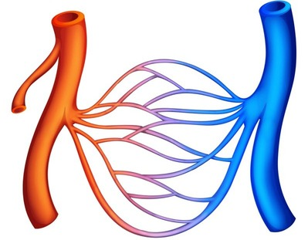
By the end of this Smart Lesson you should be able to:
1. | Explain the difference between arteries, veins and capillaries.
2. | Describe how you can take your pulse.

Slide 3
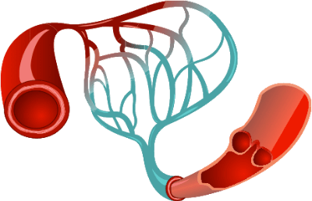
Blood vessels are the highways in your body that are used to link all body systems.
There are 3 major types of blood vessels in the body. These are: arteries, capillaries and veins.
During this Smart Lesson you will learn about each! I can almost hear your blood pressure rising with excitement! Let's get started!

Slide 4


Slide 5
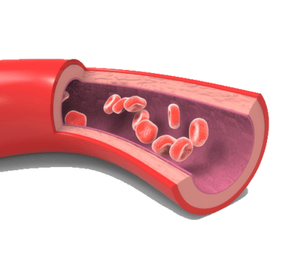
Arteries take blood away from the heart
Each time your heart beats, blood is forced into large arteries. Arteries are blood vessels that carry blood away from the heart to other tissues.
A trick to remembering: Arteries carry blood Away from the heart. Veins carry blood into the heart.

Slide 6
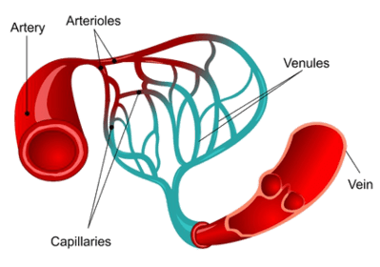
Arterioles
From the large arteries, blood starts its one-way journey around the body, moving into smaller and smaller arteries, eventually moving into the arterioles.
Arterioles are small branches of arteries that lead into capillaries.

Slide 7
The microscopic capillaries serve as the location for the exchange of gases and nutrients between blood and tissue cells.
Capillaries are the alleyways that extend and branch into every tissue of your body, ensuring that every cell has a blood supply.

Slide 8
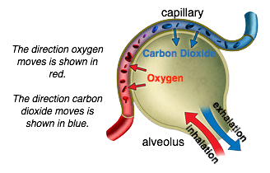
Cells pick up oxygen and drop off carbon dioxide at the capillaries
It is here, in the capillary beds, that your cells pick up oxygen and nutrients and drop off carbon dioxide and wastes.

Slide 9
Veins
After leaving the capillary beds, blood starts its trip back to the heart by first entering venules, which are groups of capillaries that unite to become small vessels that drain the capillary bed.
These small vessels in turn empty into larger vessels called veins.

Slide 10
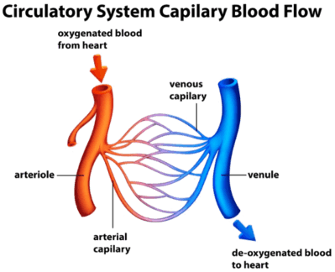
Veins are blood vessels that carry blood toward the heart from various tissues.
One-way flaps, called valves, in your veins keep blood flowing in the right direction.

Slide 11
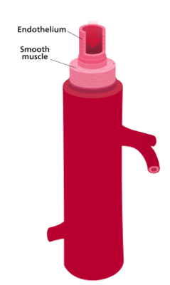
In order to cope with the high blood pressure exiting the heart, arteries have thick, muscular walls made out of smooth muscle.
This also allows arteries to move blood faster to the cells that need it.

Slide 12
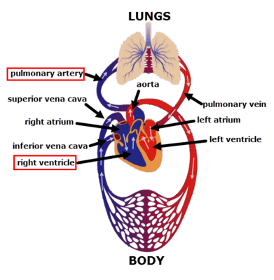
Arteries carry oxygenated blood.
This makes sense because they carry blood away from the heart.
Blood moving away from the heart has already passed through the lungs to receive oxygen. The only exception to this rule is the pulmonary artery. It's the only artery that carries deoxygenated blood towards the lungs.

Slide 13
Capillaries have very thin walls. They are only one cell thick!
Some have tiny holes in them, not large enough for a blood cell to escape, but large enough for small molecules (e.g. oxygen, carbon dioxide, water) to move in and out.
This makes gas exchange in the lungs more efficient and also the transport of oxygen into tissues a lot easier.

Slide 14
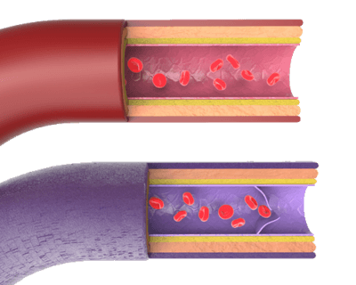
Veins operate at a lower blood pressure compared with arteries.
This is because the blood has lost considerable pressure after travelling through the arteries and capillaries.
Therefore, veins are less muscular than arteries.

Slide 15
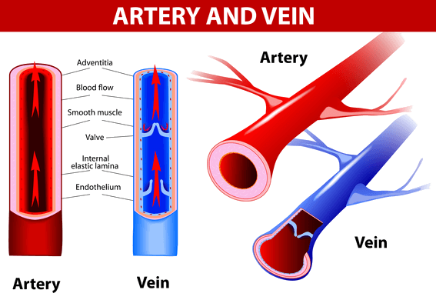
Because the blood in veins is under low pressure and are working against gravity in the lower limbs, blood has a tendency to flow backwards.
To stop this happening, veins have valves, which keep the blood moving towards the heart.

Slide 16
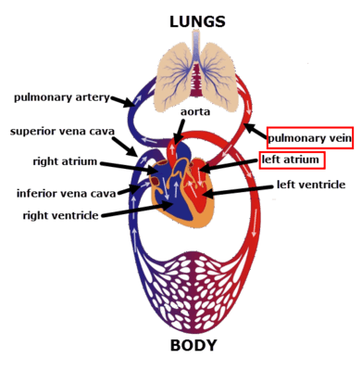
Veins carry deoxygenated blood.
This makes sense because they carry blood towards the heart.
Blood moving towards the heart has already passed through body tissues where oxygen has been used. The only exception to this rule is the pulmonary vein. It's the only vein that carries oxygenated blood away from the lungs and into the heart.

Slide 17


Slide 18
Differences between arteries and veins
Study the image below. Notice how even though the vessels are the same diameter, the arteries (shown in red) have thicker, more muscular walls in comparison to veins. Also, make sure you can identify that veins (shown in blue) have valves.
These are key differences between veins and arteries that you should be able to identify.

Slide 19
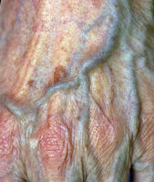
Artery and Vein Location
In arteries the blood is at high pressure. As a result of this, any damage to an artery can create a potentially dangerous wound. They are located deep inside the body, away from the surface of the skin, where they are less likely to get cut or damaged.
As veins carry low pressure blood, there is much less danger if they get damaged. Therefore, veins are found close to the surface of the skin, as you can see in this photo.

Slide 20
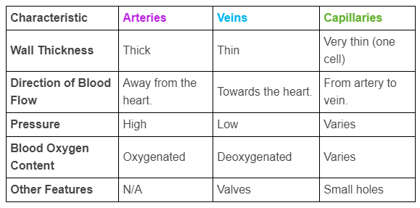
Blood Vessel Summary

Slide 21
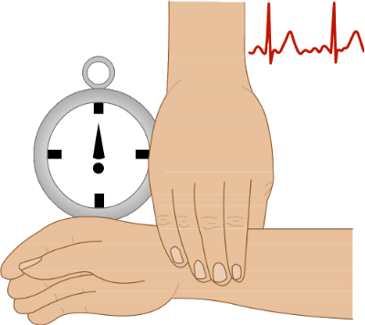
You may have seen people taking their pulse before.
Do you know what they are actually timing?
In the next few slides, we will cover what creates your pulse and how you can find and measure it yourself!

Slide 22
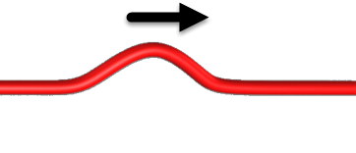
What you are actually feeling when you take your pulse are the pulses of blood along your arteries.
This is because arterial blood is under such high pressure, that each time the heart beats, a wave of blood can be felt in your arteries.

Slide 23
The only difficulty in finding your pulse is that arteries are often deep under your skin. Because of this, there are only a few places you can take your pulse from, where the arteries are close enough to the surface to feel.
This is on your neck or on your wrist.

Slide 24


Slide 25

Use the video below as a timer, count how many times you feel your pulse during the one minute duration, either on your neck or on your wrist.

Slide 26
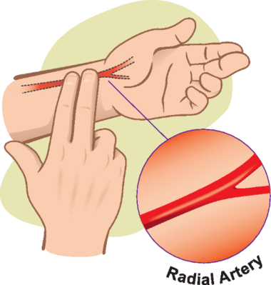
Congratulations, hopefully you have successfully found your pulse!
You have felt the rush of blood along your arteries and you now know how fast your heart is beating! That's pretty cool, don't you think?!

